Slide 1

Removing noise from images using GANs
Final results
Claudiu-Adrian ADAM

Slide 2
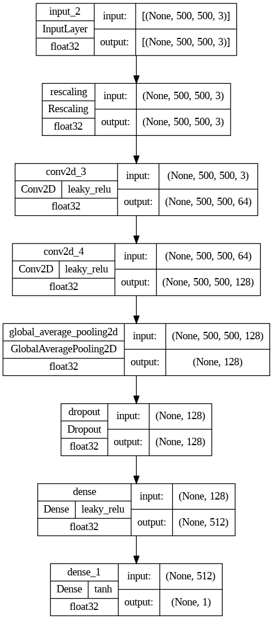
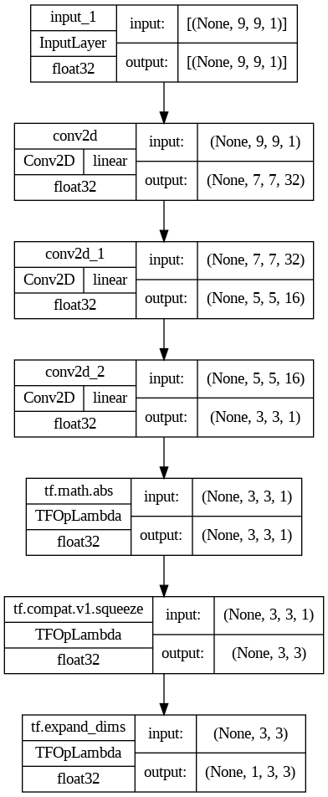
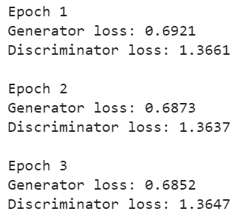

Architecture and metrics
The GAN was trained for 3 epochs, each epoch was timed at about 1 minute (≈1h/epoch for the original resolution of the images). The SIDD-Small dataset was used for training, containing 160 pairs of normal and noisy images.
The generator consisted of a CNN that gradually constucted a filter that was used later for filtering the noise from images.
The disciminator is also a CNN that is given at input each epoch the normal image without the noise and the filtered noisy image using the generated filter.
DISCRIMINATOR
GENERATOR

Slide 3
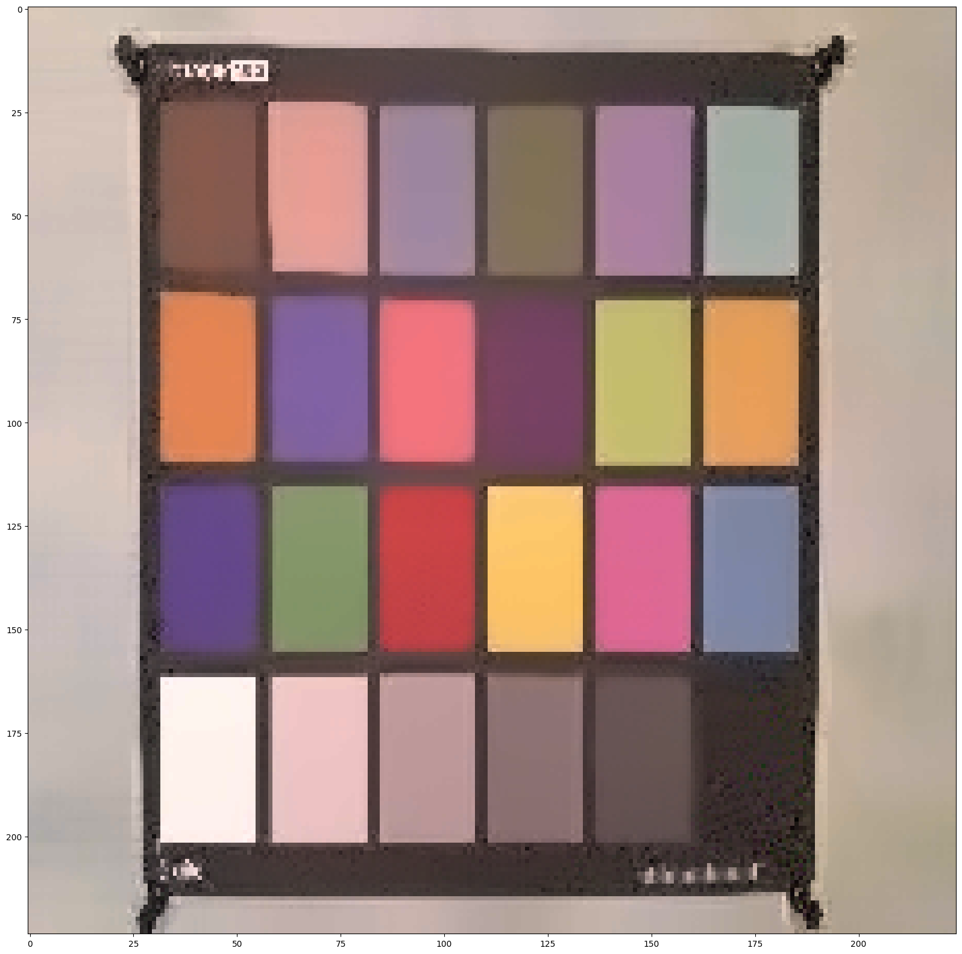
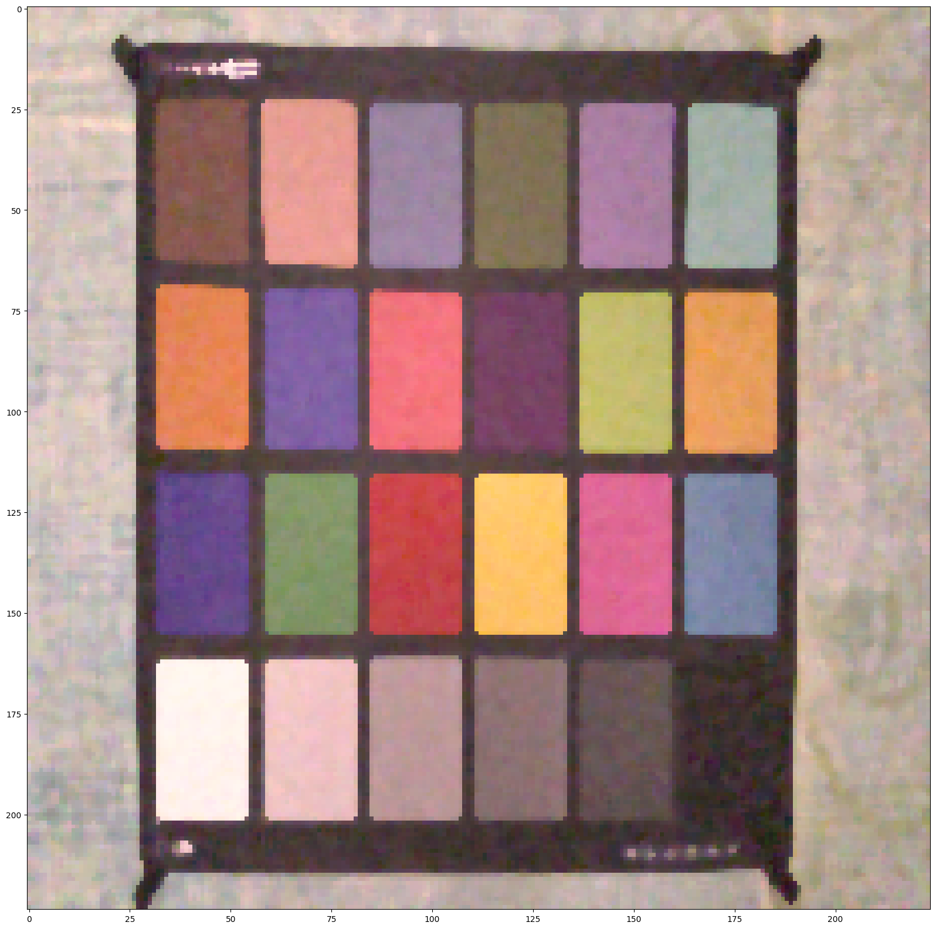



NON-LOCAL MEAN
MEDIAN
MEAN
Baseline results
Multiple filters used for denoising images were used as baseline.
The filters that generated good results for the denoising task, compared to the GAN, were median, bilateral, and non-local mean filter.
The images were dowsampled to 224x224 pixels for better visualizing the results.
BILATERAL
GAUSSIAN

Slide 4


GAN results
The GAN, if trained for a small number of epochs, gets good results in denoising the images, but the color palette of the output images is heavily affected and the image washes off over time.
To get rid of this effect, the final 3x3 filter that gets generated can be normalized for better results.
Also, a higher number of training samples for the dataset can help in improving the denoising results.
Other deep learning-based denoising techniques may grant better results than Generative Adversarial Networks, such as the Denoising Autoencoder or Denoising CNN.

